Slide 1

OPEN LAB PROJECT
Faculty In-Charge –
Ms Jeeva Priya
Ms Sreeja Kochuvila

Slide 2
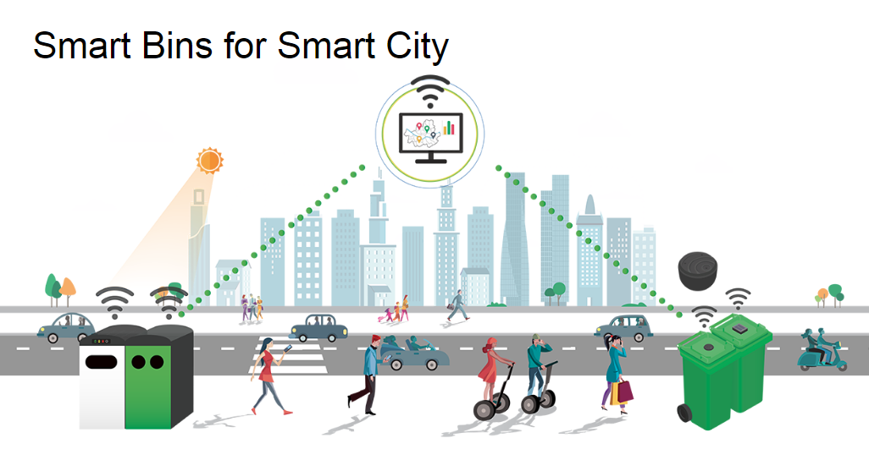
SMART TRASH CAN

Slide 3
Team
I Rohan | BL.EN.U4ECE16067
K Sri Sailesh | BL.EN.U4ECE16074
Ramoji CH L Jajam | BL.EN.U4ECE16070

Slide 4
Abstract
In the recent years, Urbanization has increased tremendously. Waste management has been a crucial issue
In some places, littering is a serious offence and hence Public Waste Containers are the only way to dispose small waste.
Requires a constant checking of the Trash can which is a very tedious task
Real time indication of Garbage Level in the dustbin at any time is essential.
Detects whether the kind of waste being dumped in the bin to an extent which it a step closer in detecting the waste in the trash can.

Slide 5
Introduction
In this project , we are going to make an IOT based garbage monitoring system
Whenever the trash can is empty or full, a message will be sent to the webpage.
It detects the trash off the can to a particular distance, whether it’s spilled around the dustbin which tells it is overflowing
Also detects the kind of waste that has been dumped
One can know the status of their ‘Trash Can’
Can be installed in the Trash Cans at public places as well as at home

Slide 6
Components Required
Arduino Uno ESP8266 Wi-Fi module HC-SR04 Ultrasonic sensor 1K Resistors Breadboard Connecting wires
• Moisture Sensor FC-28

Slide 7
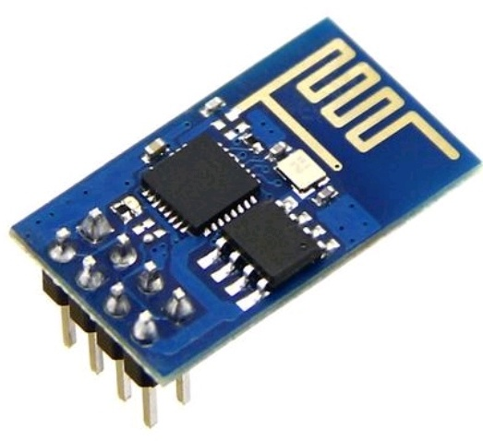
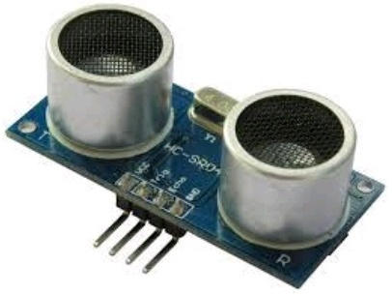
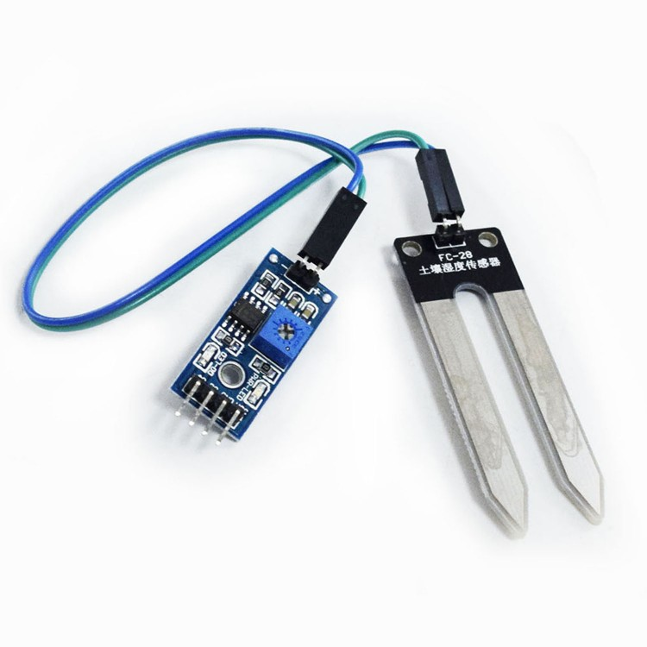
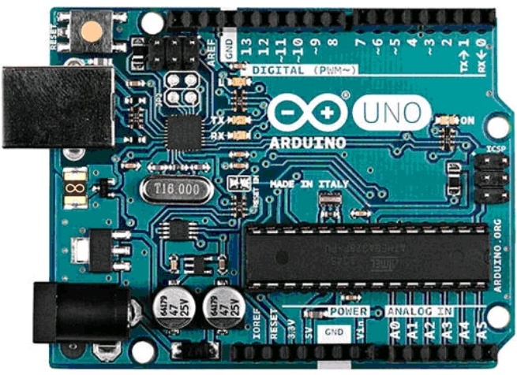
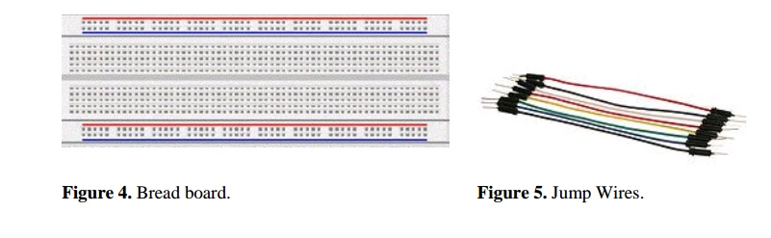

Slide 8
Procedure for Garbage Level Detection
Ultrasonic Sensor is used for detecting whether the trash can is filled with garbage or not and distance litter outside the bin
Ultrasonic Sensor is installed at the top of Trash Can to measure the distance of garbage from the top.
It can measure distance from 2cm to 400cm or from 1 inch to 13 feet.
It emits an ultrasound wave at the frequency of 40KHz in the air.

Slide 9
Procedure for Garbage Level Detection (Cont)
For every certain range a LED is provided.
LED glows when the object is in that range
If the distance is too low, LED stops glowing.

Slide 10
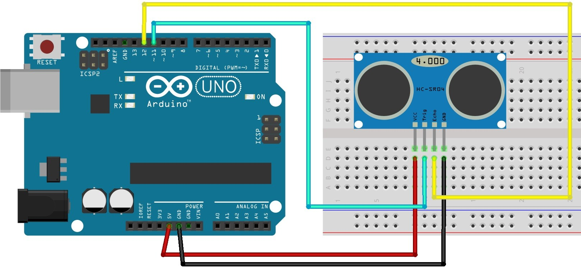
Circuit Diagram

Slide 11
Procedure for Internet connectivity
ESP8266 is a Wi-Fi module which will give access to Wi-Fi or internet.
It runs only on 3.3V and if you will give it 5V then it will get damaged.
Connect the VCC and the CH_PD to the 3.3V pin of Arduino.
We will have to make a voltage divider for the Rx pin of the module. Three 1k resistors connected in series will do the work.

Slide 12
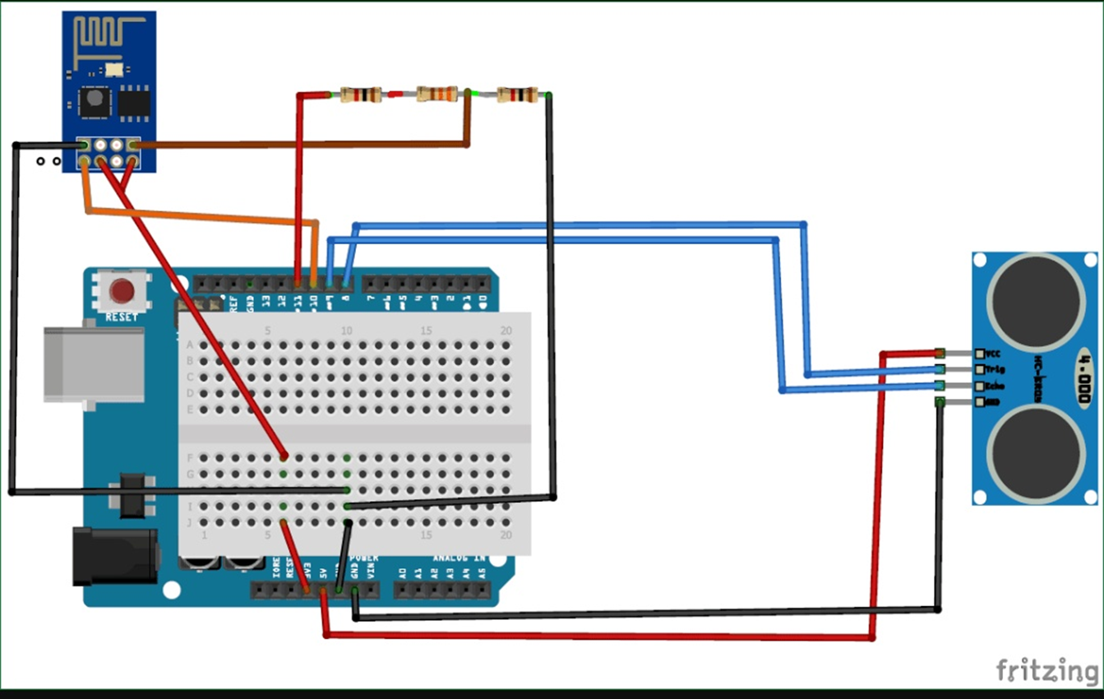
Circuit Diagram

Slide 13
Procedure for Detecting the type of Waste
The soil moisture sensor consists of two probes which are used to measure the volumetric content of water. The two probes allow the current to pass through the waste and then it gets the resistance value to measure the moisture value.
The soil Moisture sensor FC-28 has four pins
VCC: For power
A0: Analog output
D0: Digital output
GND: Ground
The Module also contains a potentiometer which will set the threshold value and then this threshold value will be compared by the LM393 comparator. The output LED will light up and down according to this threshold value.

Slide 14
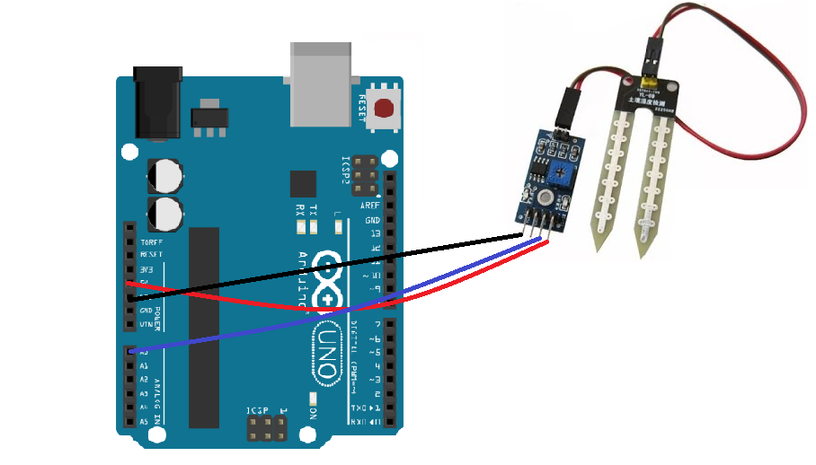
Circuit Diagram

Slide 15
Implementation
The main concept behind the Smart Dustbin using Arduino project is Object Detection.
Moisture Sensor detects the kind of waste
Fixed at the bottom to detect the waste.
Ultrasonic Sensor is used to detect the object.
Ultrasonic sensor is placed at top of the dustbin.

